Slide 1
e-Safety Safer Internet Day 2025

Slide 2
E-safety is often defined as the safe and responsible use of technology. This includes the use of the internet and also other means of communication using electronic media (eg text messages, gaming devices, email etc). In practice, e-safety is as much about behaviour as it is electronic security.

Slide 3
Children today are firmly part of the digital age and as such, they often use a wide range of devices, both inside and outside, of school. When used correctly, technology can be a fantastic learning and social tool, but children need to have a clear understanding of the e-safety rules and expectations. This will help them to stay safe online and not fall foul of the myriad of risks and threats which can occur to the unsuspecting individual.

Slide 4
There are three areas of risk to children online (although the breadth of issues within each may be considerable). They are:
Content – illegal, inappropriate or harmful material
Contact – harmful online interactions with advertising or individuals
Conduct – personal online behaviour which can cause harm

Slide 5
61% do not trust news posted on social media
However, there is still much more that can be done to help educate children on e-safety. Children need to be taught how to underpin their knowledge and understand behaviours, so that they can use the Internet safely. This can include:
Some of the most positive stats from the Ofcom research are:
96% of children who go online recall being told guidance around how to use the Internet safely
84% say that this guidance came from either their parents or their teachers
2/3 of children have said that they have used social media to offer personal, positive support to their friends who are having a hard time

Slide 6
How to evaluate what they see online
Pupils will need to understand that not everything they see online is ‘true, valid or acceptable’ and that sometimes people are not who they say they are or are not sharing real information. Some key questions to ask are:
Is this fact or opinion? Why am I being sent this? Should I share this?
Is this content/website/link/email fake? What information am I sharing and with who? Is this person who they say they are? What’s the reason behind this post / comment?

Slide 7
How to recognise persuasion techniques
This can help pupils to avoid manipulation and be more aware of the techniques used by those who are attempting to do harm. They can also recognise and respond appropriately to malicious or detrimental activity or requests.

Slide 8
* Am I being persuaded to buy something?
* Am I being asked to do something I’m not comfortable with?
* Am I being asked to share personal or sensitive information?
* Is the information I’m reading true or false?
* Is this service/product/advert legitimate?
* Do I want to keep playing this game / using this website?
* Do I trust this person?
* Do I know this person?
How and when to seek support
This enables pupils to understand how to seek support if they are upset, concerned or confused by anything they see online. This can include:
Helping them to identify trusted adults Access support from their school, the police.
Understanding how to report inappropriate content on individual platforms, apps and channels.

Slide 9
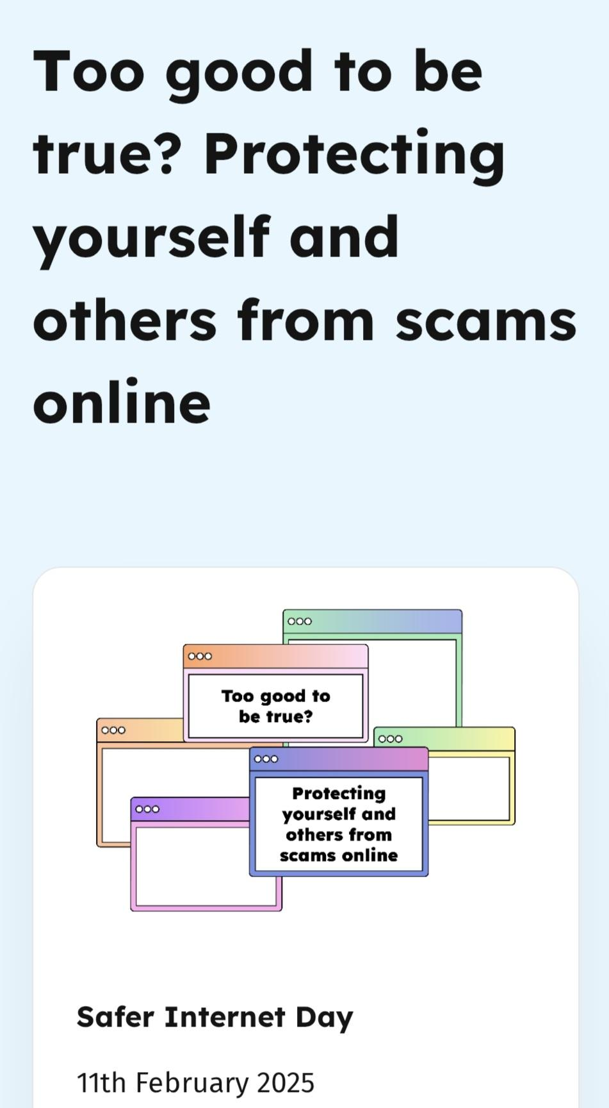

Slide 10
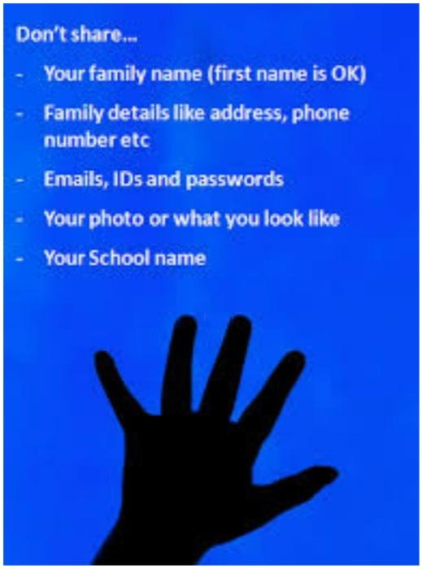
Can you share one more precaution wih us to be safer on the net?

Slide 11
REFERENCES
e4education.co.uk
virtual-college.co.uk

